Slide 1

EXCEL REASSESMENT
BY
SANGAVI V 4302

Slide 2
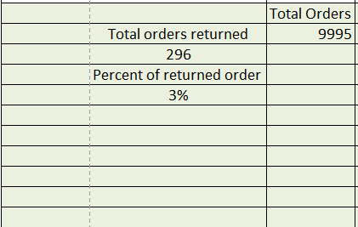
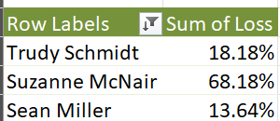
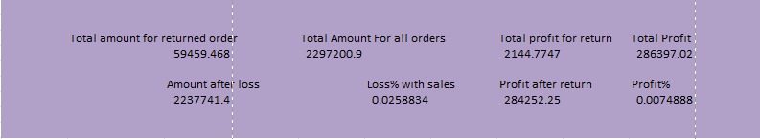
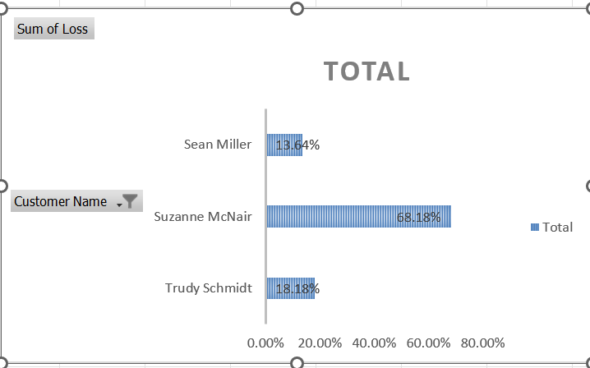
Q-1
Formula:
Profit Margin:=(AE9/AE6)*100,Total Sales:=SUM(S:S)
Insights
In order to check the performance of the business we need to analyse the sales and profit.
Inference
We infer that around 3% of the orders where returned.
Trudy Schmidt has the highest order return.

Slide 3
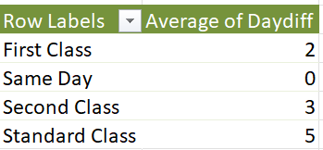
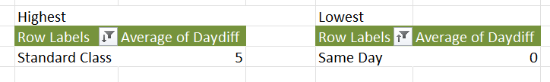
Q-2
Formula:Pivot Table:
Insights
The Shipment plays a key role in customer satisfaction and Retention.
It Affects the customer acquisition
Inference
We infer that standard class has the Slowest shipping
Same Day shipment is the fastest

Slide 4
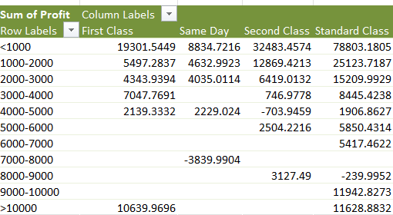
Q-3
Formula: Pivot Table
Insights
Customer with different priority contributes differently to the way the business gets profit.
Inference
We infer that sales over 10000 has good Profit and based on the shipment mode Standard class performs better than the first class.

Slide 5
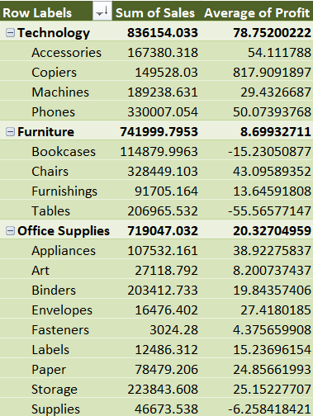
Q-4
Formula:Pivot Table
Insights
Category which sells high has higher probability of going out of stock
Its good to analyse the type which customer prefers.
Inference
We infer that Technology performs better and in that Accessories perform good.
The profit is higher for this category.

Slide 6
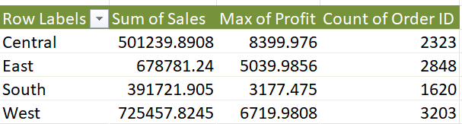
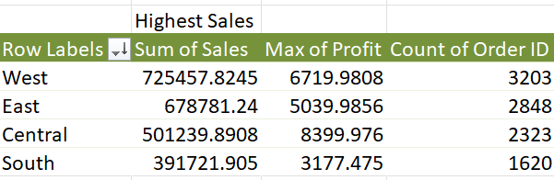
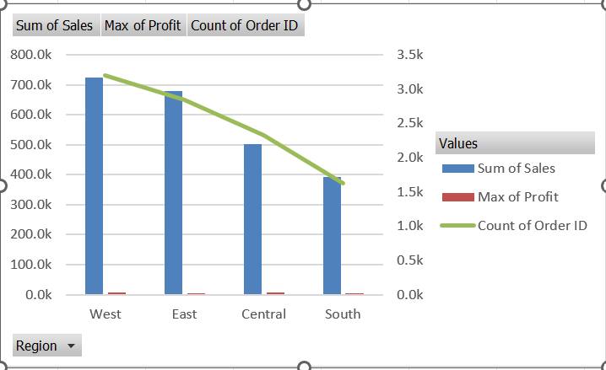
Q-5
Formula:Pivot Table
Insights
Which region is better at selling the products can help in increasing the sales of similar products or the same product in future.
Inference
We infer that west region has highest sale among the others.

Slide 7
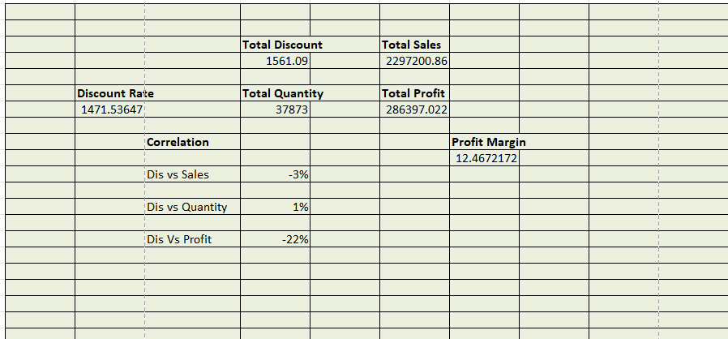
Q-6
Formula:Pivot Table
Insights
Correlation is important to find the impact of different metrics which directly or indirectly affect the scale of growth.
Inference
We infer that discount on quantity has some good correlation.
While Profit and discount has less correlation.

Slide 8
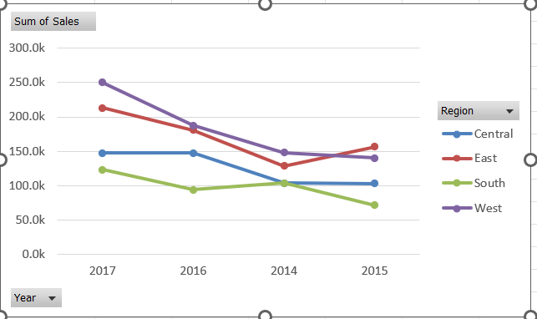
Q-7
Formula:Pivot Tavle
Insights
Targeting the customer based on the geographical locations can also help in improving their satisfaction on different product.
Inference
We infer that central performs better compared to others.
While East region may not be good as central but it has potential if we increase the Sales.

Slide 9
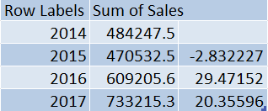
Q-7
Year on Year growth analysis can be done in order to understand the pattern.
Local market analysis is important to establish new unit in the region.
After that analysis of products that sells good can be a key factor.
Target audience is also important to have a reach

Slide 10
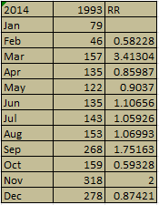

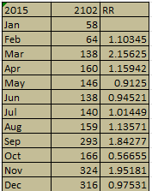
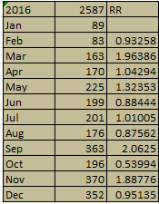
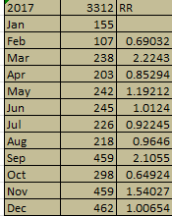
Q-8
Formula:Pivot Table
Insights
Retention of the customer is important to have a good growth.
Inference
We infer that retention rate of the customer year wise has a good impact.

Slide 11
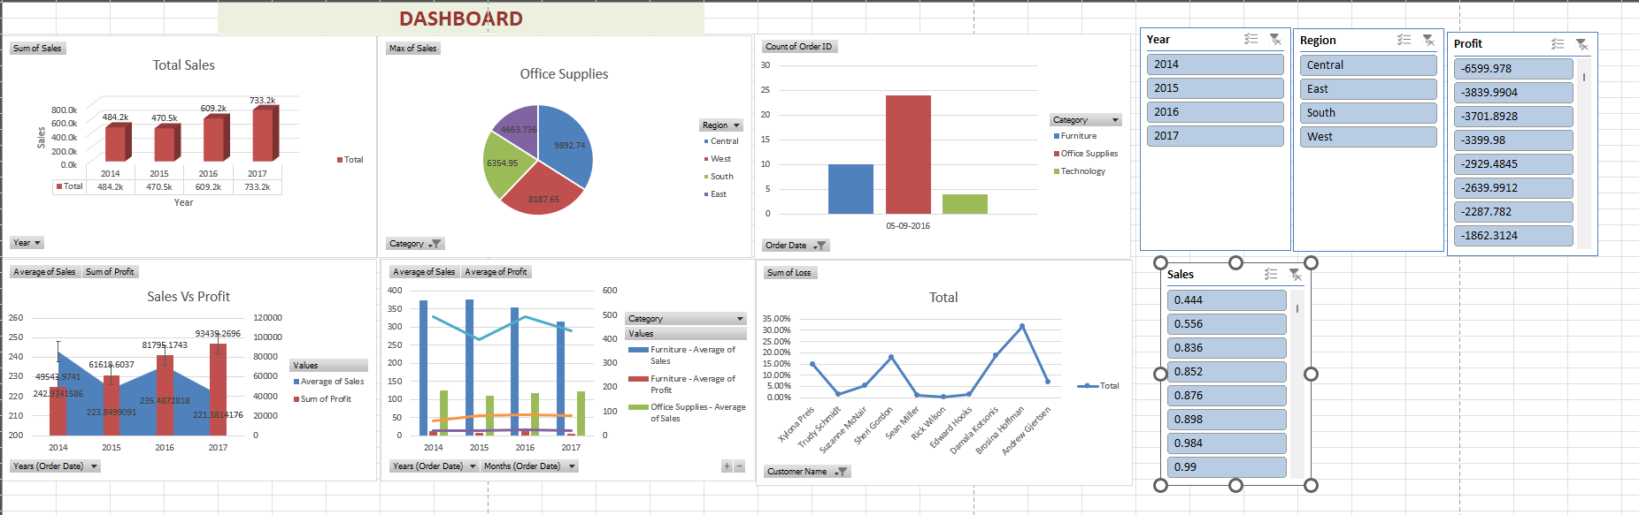
Q-9

Slide 12
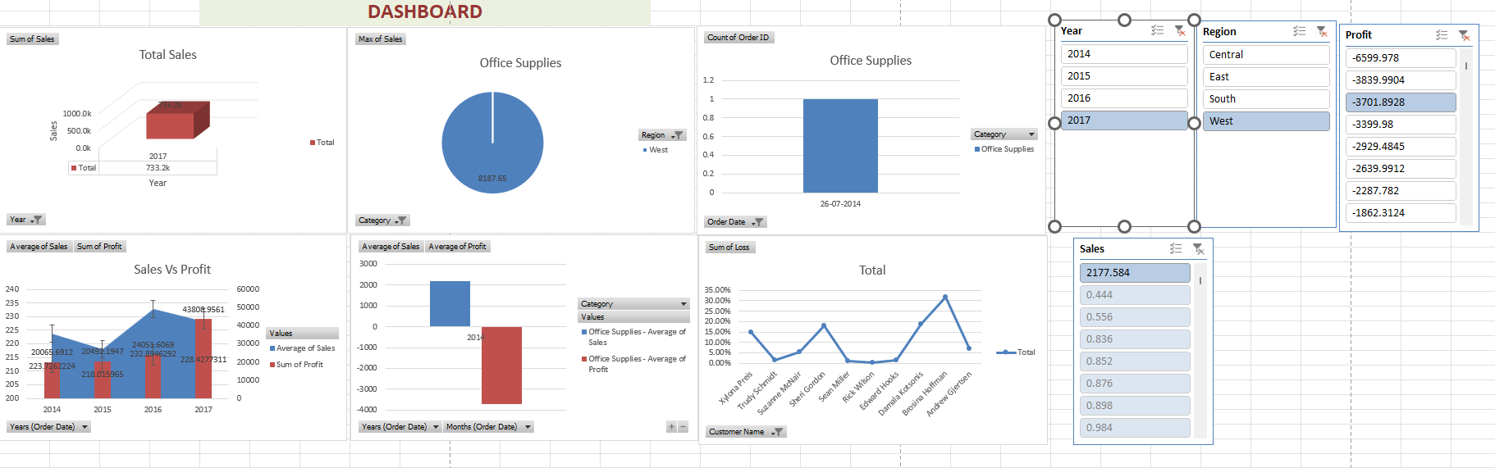
Q-9

Slide 13
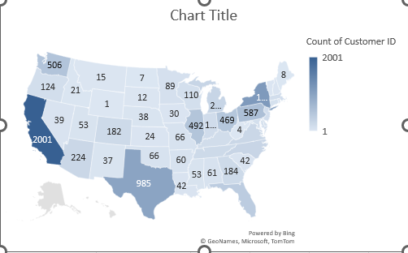
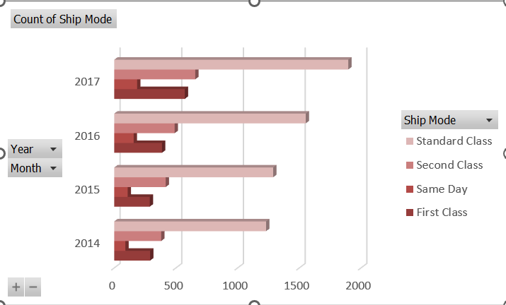
Q-9

